Slide 1

Compose for
Multiplatform
王鹏
2021.12.19

Slide 2
Compose Multiplatform =
Jetpack Compose + Kotlin Multiplatform

Slide 3
Contents
Jetpack Compose (4 mins)
Kotlin Multiplatform (4 mins)
Compose Multiplatform (10 mins)
Sample (10 mins)
Summary (2 mins)

Slide 4
Jetpack Compose

Slide 5

Jetpack Compose
Android’s modern toolkit for building native UI. It simplifies and accelerates UI development with declarative Kotlin APIs.
@Composable
fun JetpackComose() {
Card {
var expanded by remember { mutableStateOf(false) }
Column(Modifier.clickable { expanded = !expanded }) {
Image(painterResource(R.drawable.jetpack_compose))
AnimatedVisibility(expanded) {
Text(
text = "Jetpack Compose",
stye = MaterialTheme.typography.h2
)
}
}
}
}

Slide 6
Unidirectional Data Flow
data class ExampleUiState(
val userMessages: List<Message> = emptyList(),
val loading: Boolean = false
)
class ExampleViewModel(
private val repository: MyRepository,
private val savedState: SavedStateHandle
) : ViewModel() {
var uiState by mutableStateOf(ExampleUiState())
private set
// Business logic
fun someBusinessLogic() { /*...*/) }
}
@Composable
fun ExampleScreen(viewModel: ExampleViewModel = viewModel()) {
Column {
Button(onClick = { viewModel.someBusinessLogic() }) {
Text("Do something")
}
Column {
viewModel.uiState.userMessages.forEach {
Text("$it")
}
}
}
}
Reactive programming - When state changes the UI automatically re-renders itself.
Single source of truth - State is managed in only one place to avoid updating it's value everywhere.
Separation of concerns - Composable is in charge of UI, and ViewModel contains the logic and states.
ExampleViewModel
state
event
ExampleScreen

Slide 7
Kotlin Multiplatform

Slide 8
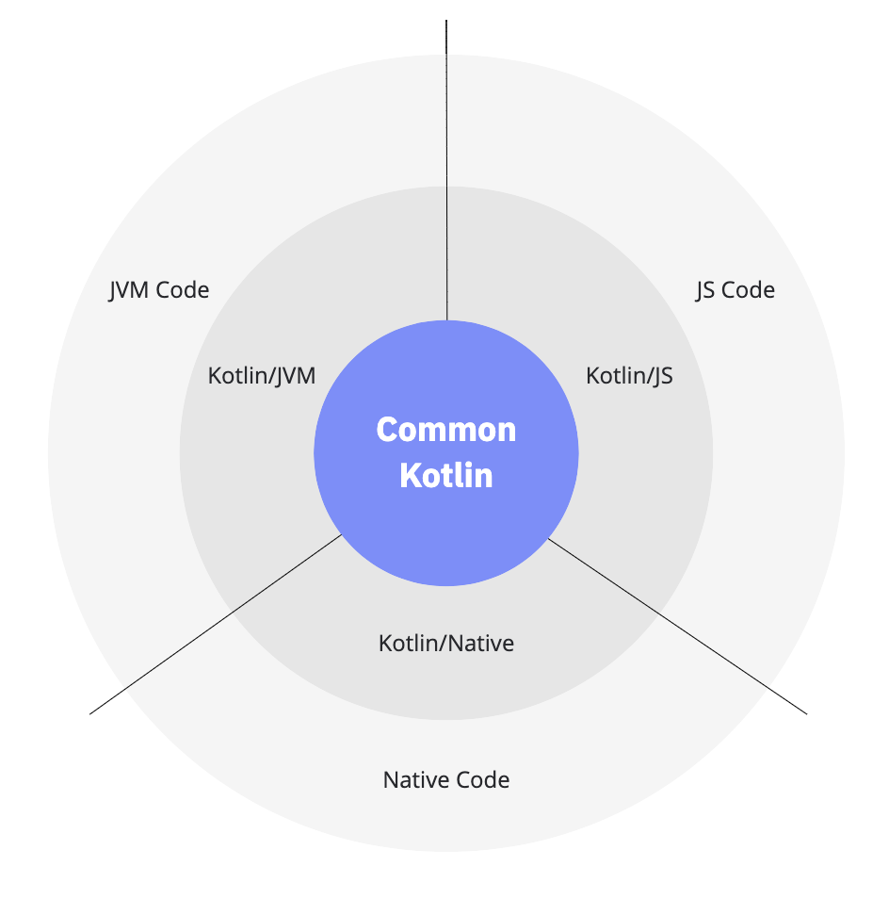
Kotlin Multiplatform
Code written in Common Kotlin works everywhere on all platforms.
Use Platform-specific versions of Kotlin to interop with platforms (Kotlin/JVM, Kotlin/JS, Kotlin/Native) .
Access the platform native code (JVM, JS, and Native) and leverage all native capabilities.
Use expect/actual declarations to acess platform-specific APIs from shared code.

Slide 9
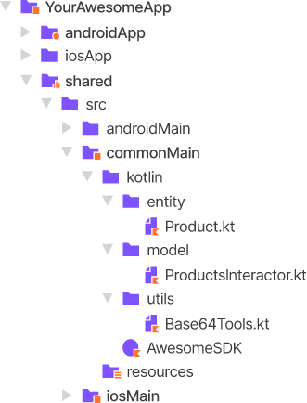
Kotlin Multiplatform Mobile
androidApp – a Kotlin module that builds into the Android application. Uses Gradle as a build system.
iosApp – an Xcode project that builds into the iOS application.
shared – a Kotlin module that contains common logic for both Android and iOS applications. This module is organized in three source sets :
commonMain - stores the code that works on both platforms, including the expect declarations.
androidMain - stores Android-specific parts, including actual implementations.
iosMain - stores iOS-specific parts, including actual implementations.

Slide 10
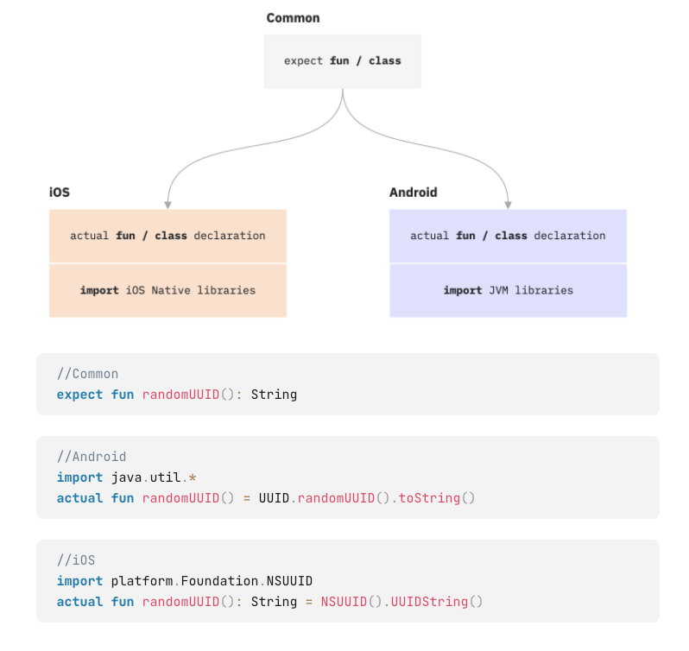
Kotlin Multiplatform Mobile
Common module defines an expected declaration, and ios/android modules provide actual declarations.
The expect/actual mechanism works for most Kotlin declarations, such as functions, classes, interfaces, enums, properties, and annotations.
Each source sets can have its own dependencies.
kotlin {
sourceSets["commonMain"].dependencies {
//kotlinx.coroutines will be available in all source sets
implementation("org.jetbrains.kotlinx:kotlinx-coroutines-core:1.5.2")
//depend on another kotlin-multiplatform module
implementation(project(":other-multiplatform-module"))
}
sourceSets["androidMain"].dependencies {
//platformother-multiplatform-module is added automacitally
}
sourceSets["iosMain"].dependencies {
//SQLDelight will be available only in the iOS source set
implementation("com.squareup.sqldelight:native-driver:1.4.1")
}
}

Slide 11
Compose Multiplatform

Slide 12
Compose Teck Stack
Material - Material Design for Compose UI, providing a theming system, styled components, ripple indications, icons, etc.
Foundation - Design system agnostic Compose UI, like Row and Column, LazyColumn, recognition of particular gestures, etc.
UI - Fundamentals of the UI, such as LayoutNode, Modifier, input handlers, custom layouts, and drawing.
Runtime - Compose’s tree management abilitiesthe, such as remember, mutableStateOf, the @Composable annotation and SideEffect.
Compiler - Transform @Composable functions and enable optimizations with a Kotlin compiler plugin.
Compose Material
Compose Foundation
Compose UI
Compose Runtime
Compose Compiler

Slide 13
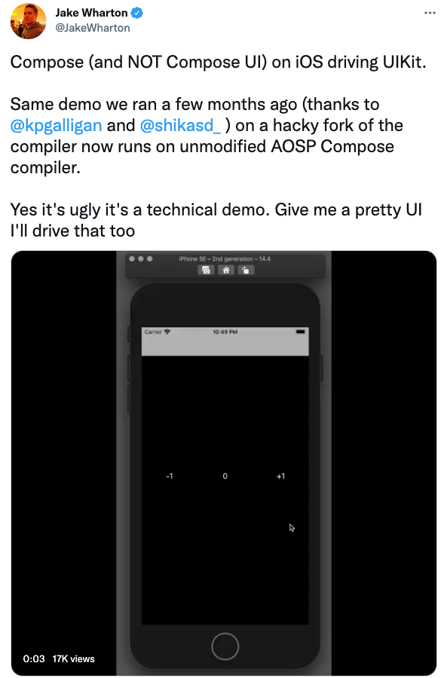
Compose Teck Stack
“Compose is, at its core, a general-purpose tool for managing a tree of nodes of any type. Well a ‘tree of nodes’ describes just about anything, and as a result Compose can target just about anything.
The nodes don’t have to be UI related at all. The tree could exist at the presenter layer as view state objects, at the data layer as model objects, or simply be a value tree of pure data.”
– Jake Wharton

Slide 14
Compose Runtime
internal class UiApplier(
root: LayoutNode
): AbstractApplier<LayoutNode>(root) {
override fun insertTopDown(index: Int, instance: LayoutNode) {
// Ignored.
}
override fun insertBottomUp(index: Int, instance: LayoutNode) {
current.insertAt(index, instance)
}
override fun remove(index: Int, count: Int) {
current.removeAt(index, count)
}
override fun move(from: Int, to: Int, count: Int) {
current.move(from, to, count)
}
override fun onClear() {
root.removeAll()
}
override fun onEndChanges() {
super.onEndChanges()
(root.owner as? AndroidComposeView)?.clearInvalidObservations()
}
}
As the visitor of nodes, the Applier provides operations to traverse the tree, insert, remove, or move nodes around.
Composable are executed during the Composition, and the changes are recorded to slot table. Based on these changes node tree will be updated via Applier.
Applier
update
node tree
Composition
update
node property
Node

Slide 15
JetBrains Compose
Compose Runtime provides underlying machinery to manage UI or any other tree hierarchies almost everywhere as long as it runs Kotlin.
Compose for Desktop is close to the Android, reusing the whole rendering layer of Compose UI with Skia wrappers. The event system was also extended to support mouse/keyboard.
Compose for Web relies on browser DOM for displaying elements, reusing only compiler and runtime. The available components are defined on top of HTML/CSS, resulting in a different system from Compose UI. The runtime and compiler, however, are used almost the same way.
Compiler
Runtime
Compose
UI
Android
UI
Compose
Web
Compose
Desktop

Slide 16
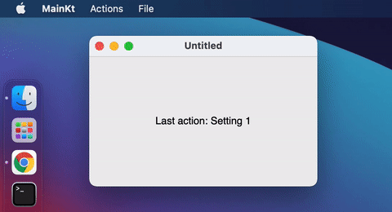
Compose for Desktop
fun main() = application {
var action by remember { mutableStateOf("Last action: None") }
var isOpen by remember { mutableStateOf(true) }
if (isOpen) {
var isSubmenuShowing by remember { mutableStateOf(false) }
Window(onCloseRequest = { isOpen = false }) {
MenuBar {
Menu("File", mnemonic = 'F') {
Item("Copy", onClick = {}, shortcut = KeyShortcut(Key.C, ctrl = true))
Item("Paste", onClick = {}, shortcut = KeyShortcut(Key.V, ctrl = true))
}
Menu("Actions", mnemonic = 'A') {
CheckboxItem(
"Advanced settings",
checked = isSubmenuShowing,
onCheckedChange = {
isSubmenuShowing = !isSubmenuShowing
}
)
if (isSubmenuShowing) {
Menu("Settings") {
Item("Setting 1", onClick = { })
Item("Setting 2", onClick = { })
}
}
Separator()
Item("About", icon = TrayIcon, onClick = { })
Item("Exit", onClick = { isOpen = false },
shortcut = KeyShortcut(Key.Escape), mnemonic = 'E')
}
}
Box(
modifier = Modifier.fillMaxSize(),
contentAlignment = Alignment.Center
) {
Text(text = action)
}
}
}
}
Powered by graphics library Skiko.
Excellent AWT and Swing interoperability.
Extensions for menus, keyboard shortcuts, window manipulation, notification management, and more.

Slide 17
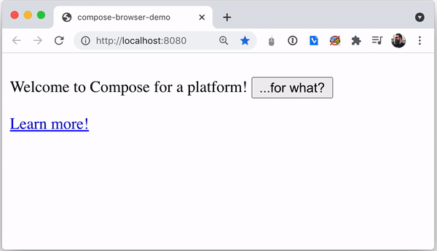
Compose for Web
//DSL for style sheets
class MyStyle: StyleSheet(AppStylesheet) {
val styledHeading by style {
color("#27282c")
fontSize(60.px)
media(maxWidth(640.px)) {
self style {
backgroundColor("lightgray")
this.justifyContent(JustifyContent.Center)
fontSize(42.px)
}
}
}
}
//DOM API
fun main() {
renderComposable("root") {
var platform by remember { mutableStateOf("a platform") }
P {
Text("Welcome to Compose for $platform! ")
Button(attrs = { onClick { platform = "Web" } }) {
Text("...for what?")
}
}
A("https://www.jetbrains.com/lp/compose-web") {
Text("Learn more!")
}
}
}
Use HTML like DOM API to describe your layouts.
Typesafe DSL for style sheets, which you can express CSS rules in Kotlin code.
Runtime can work with Kotlin/JS

Slide 18
Compose Multiplatform
Compose
announced
Compose
Beta
Compose
1.1.0 Beta
Compose
Alpha
Compose
1.0
Jetpack
Compose
May 2019
Aug 2020
Nov 2020
Feb 2021
May 2021
Jul 2021
Dec 2021
JetBrains Compose
Compose
for Web
Compose
for Desktop
Multiplatform
Alpha
Multiplatform
1.0

Slide 19
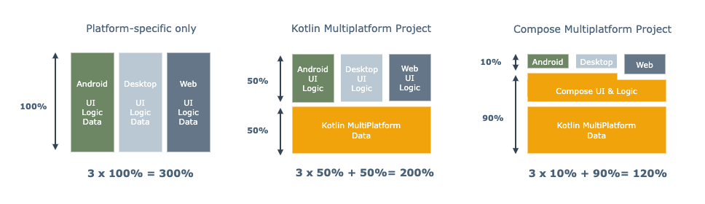
Compose Multiplatform
Compose Multiplatform simplifies and accelerates UI development for Desktop and Web applications, and allows UI code sharing between Android, Desktop and Web with the same artifacts

Slide 20
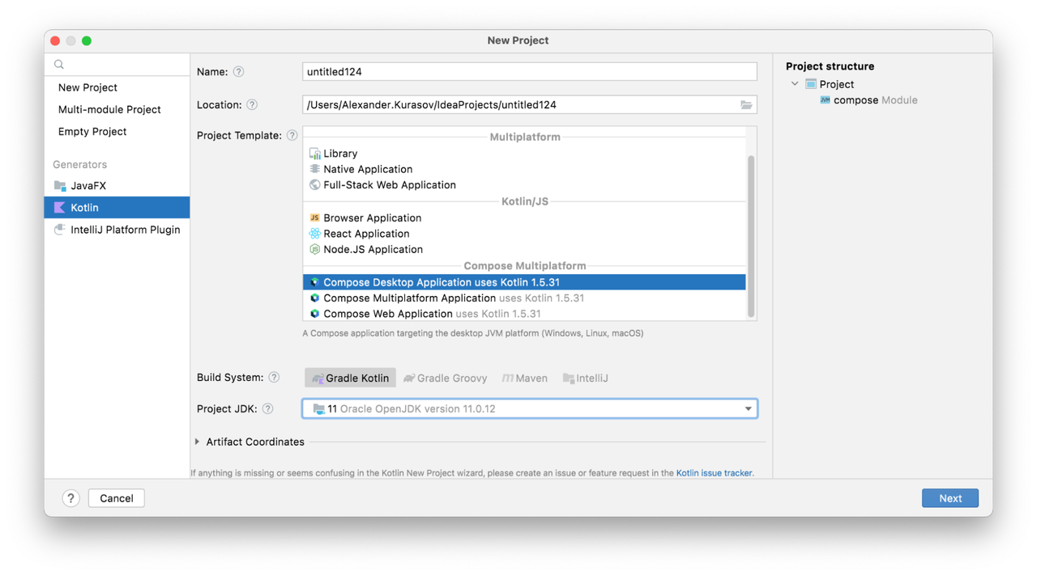
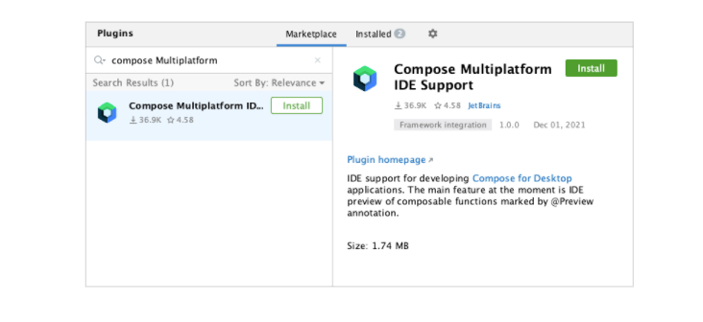
IDE & Tools
JDK 11 or later
IntelliJ IDEA Community Edition or Ultimate Edition 2020.3 or later
New project wizard and template
Compose Multiplatform IDEA plugin support preview argument-less Composable with @Preview annotation.
Use Gradle plugin to build Compose for Desktop projects.

Slide 21
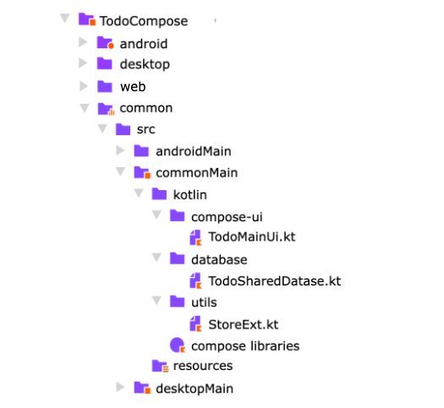
Project Structure
android – a Kotlin module that builds into the Android application
desktop – a Kotlin module that can create standalone application bundles which run without JVM .
common – a Kotlin module that contains common logic for all host applications, and organized in source sets :
commonMain - stores the code that works on both platforms, including the expect declarations
androidMain - stores Android-specific parts, including actual implementations
desktopMain - stores Desktop-specific parts, including actual implementations

Slide 22
Kotlin Libraries
Category | Library | Description
Architecture | MVIKotlin | Extendable MVI framework for Kotlin Multiplatform with powerful debugging tools (logging and time travel), inspired by Badoo MVICore library
 | moko-mvvm | Model-View-ViewModel architecture components for mobile (android & ios) Kotlin Multiplatform development
Network | Ktor | Framework for quickly creating connected applications in Kotlin with minimal effort
 | rsocket-kotlin | RSocket Kotlin multi-platform implementation
Storage | SQLDeligth | Generates typesafe Kotlin APIs from SQL
DI | koin | A pragmatic lightweight dependency injection framework for Kotlin
IO | okio | A modern I/O library for Android, Java, and Kotlin Multiplatform.
Log | Kotlin-logging | Lightweight logging framework for Kotlin. A convenient and performant logging library wrapping slf4j with Kotlin extensions
… | … | …
libs.kmp.icerock.dev/

Slide 23
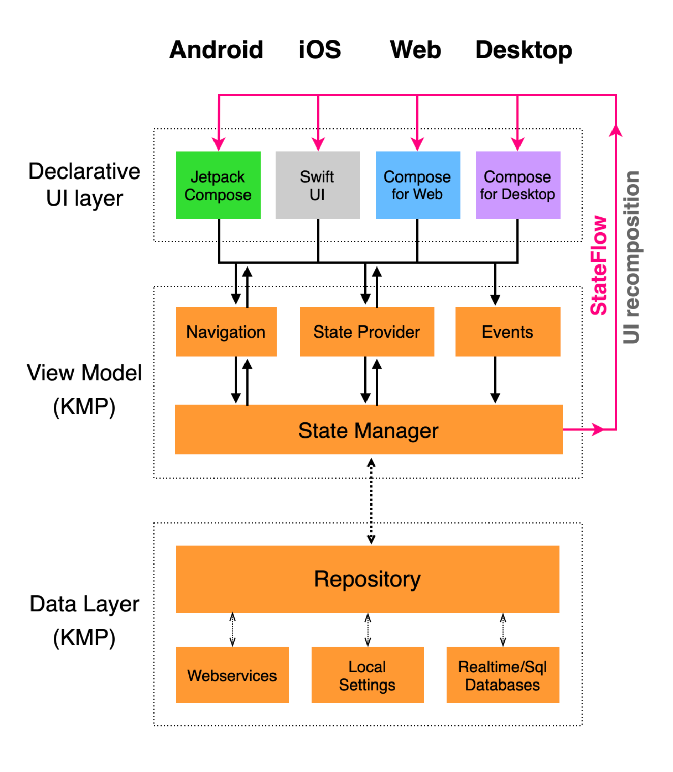
D-KMP Architecture
Declarative UI toolkits: Compose for Android and SwiftUI for iOS.
Shares the ViewModel & Data Layer via Kotlin MultiPlatform.
coroutine scopes are cancelled/reinitialized automatically based on lifecycle-aware mechanism.
Implements the MVI pattern and the unidirectional data flow
Implements the CQRS pattern, by providing Command functions (via Events and Navigation) and Query functions (via StateProviders)
Uses Kotlin's StateFlow to trigger UI layer recompositions
https://github.com/dbaroncelli/D-KMP-sample

Slide 24
Sample

Slide 25
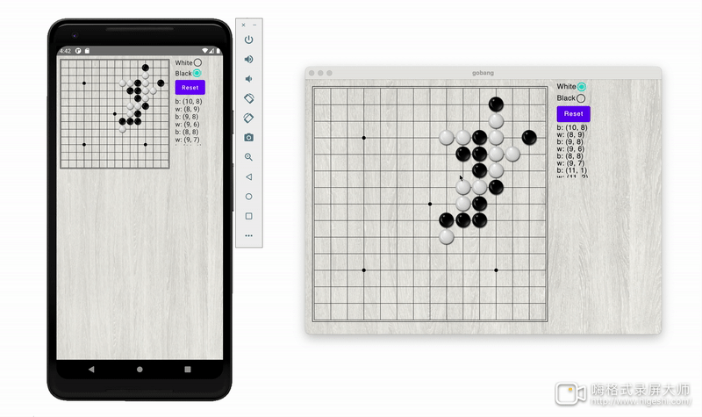
Gobang Multiplatform
https://github.com/vitaviva/cmp-gobang

Slide 26
Design Goals
Via Compose Multiplatform, the Game run on Android and Desktop terminal terminal at the same time, and source code is shared as much as possible
Share the logic & data layer by Kotlin Multiplatform libraries
Implement separation of concerns of UI layer & logic layer by using with unidirectional data flow pattern
State
State
UI
API
API
UI

Slide 27
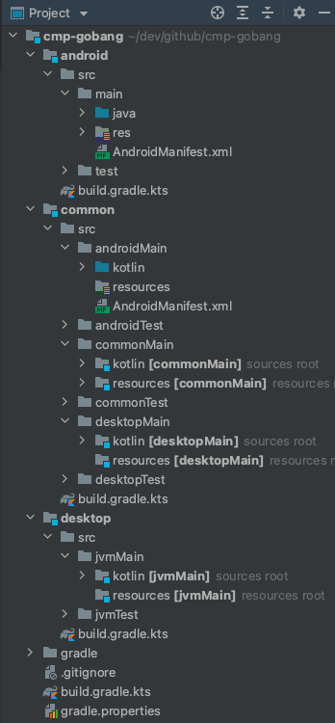
Project Structure
plugins {
kotlin("multiplatform")
id("org.jetbrains.compose")
id("com.android.library")
}
kotlin {
android()
jvm("desktop")
sourceSets {
val commonMain by getting {
dependencies {
//Compose
api("org.jetbrains.compose.runtime:runtime:$composeVersion”)
api("org.jetbrains.compose.foundation:foundation:$composeVersion”)
api("org.jetbrains.compose.ui:ui:$composeVersion”)
//RSocket & Ktor
implementation("io.rsocket.kotlin:rsocket-core:$rSocketVersion")
//MVIKotlin
implementation("com.arkivanov.mvikotlin:mvikotlin:$mviKotlinVersion")
}
}
val androidMain by getting {
dependencies {
api("androidx.appcompat:appcompat:1.3.0")
api("androidx.core:core-ktx:1.3.1")
implementation("io.ktor:ktor-client-cio:1.6.2")
implementation("io.rsocket.kotlin:rsocket-transport-ktor-client:$rSocketVersion")
}
}
val desktopMain by getting {
dependencies {
implementation ("io.ktor:ktor-server-cio:1.6.2")
implementation ("io.rsocket.kotlin:rsocket-transport-ktor-server:$rSocketVersion")
}
}
}
}

Slide 28
Architectural Layering
Android
Desktop
UI - The source code of UI which using Compose Graphic API is shared across platforms and use expect/actual to call platform-specific code such as processing about bitmap, dialog ,etc
Logic - Implement unidirectional data flow to manage UI state built on MVIKotlin library, and call API layer to communicate with remote
API - Abstract a peer-to-peer transport protocol
RSocket - Implement API protocol via Full duplex channel built on Ktor
Android
Desktop
UI：Compose
UI：Compose
Logic：MVIKotlin
Logic：MVIKotlin
API
API
RSocket Client
RSocket Server
RSocket Client
RSocket Server

Slide 29
UI：Comopose
@Composable
fun GoBoard(
modifier: Modifier,
viewModel: AppViewModel
) {
val state = viewModel.appState
val scope = rememberCoroutineScope()
Box(modifier) {
Canvas(modifier = Modifier.fillMaxSize().pointerInput(Unit) {
scope.launch {
detectTapGestures {
viewModel.placeStone(convertPoint(it.x, it.y))
}
}
}) {
drawLines()
drawBlackPoints()
drawStones(state.boardData)
}
}
}
private fun convertPoint(x: Float, y: Float): IntOffset {
val i = round((x / GridWidth).toDouble()).toInt()
val j = round((y / GridWidth).toDouble()).toInt()
return IntOffset(i, j)
}
Android
Desktop
UI：Compose
UI：Compose
Logic：MVIKotlin
API
RSocket Client
RSocket Server

Slide 30
Logic：AppViewModel
class AppViewModel {
private val store =
AppStateStoreProvider(DefaultStoreFactory()).provide()
var appState by mutableStateOf(AppStateStore.State())
init {
store.states(observer(onNext = {
appState = it
})
coroutineScope.launch {
Api.receiveMessage().collect { msg ->
store.accept(
when (msg) {
is Message.PlaceStone ->
Intent.PlaceStone(
msg.offset,
store.state.stoneColor != STONE_WHITE)
is Message.ChooseColor ->
Intent.SetStoneColor(!msg.isWhite)
//…
}.apply {
localIntent = false
}
)
}
}
}
fun placeStone(offset: IntOffset) {
store.accept(Intent.PlaceStone(
offset, store.state.stoneColor == STONE_WHITE)
)
}
}
Android
Desktop
UI：Compose
Logic：MVIKotlin
Logic：AppViewModel
API
RSocket Client
RSocket Server

Slide 31
Logic：MVIKotlin
interface AppStateStore : Store<Intent, State, Unit> {
sealed class Intent {
var localIntent: Boolean = true
data class PlaceStone(
val offset: IntOffset,
val isWhite: Boolean) : Intent()
data class SetStoneColor(
val isWhite: Boolean) : Intent()
}
data class State(
val boardData: BoardData = emptyArray(),
val stoneColor: Int = STONE_NONE,
val gameStatus: Int = GAME_PLAYING
)
}
Android
Desktop
UI：Compose
Logic：MVIKotlin
Logic：MVIKotlin
API
RSocket Client
RSocket Server

Slide 32
Logic：MVIKotlin
internal class AppStateStoreProvider(
private val storeFactory: StoreFactory,
) {
fun provide(): AppStateStore =
object : AppStateStore,
Store<Intent, State, Unit> by storeFactory.create(
initialState = State(),
executorFactory = ::ExecutorImpl,
reducer = ReducerImpl
) {}
private inner class ExecutorImpl :
CoroutineExecutor<Intent, Unit, State, Result, Unit>() {
override fun executeIntent(intent: Intent, getState: () -> State) {
when (intent) {
//…
}
}
}
private object ReducerImpl : Reducer<State, Result> {
override fun State.reduce(result: Result): State =
when (result) {
is Result.StonePlaced ->
copy(boardData = result.boardData)
is Result.StatusChanged ->
copy(gameStatus = result.gameStatus)
}
}
}
Store
Result
Executor
Reducer
Intent
State
UI

Slide 33
Logic：MVIKotlin
//executeIntent
when (intent) {
is Intent.PlaceStone -> {
if (intent.localIntent) {
scope.launch {
Api.sendMessage(Message.PlaceStone(intent.offset)) }
}
with(getState()) {
val boardData = boardData.copyOf().also {
it[intent.offset.x][intent.offset.y] =
if (intent.isWhite) STONE_WHITE else STONE_BLACK
}
dispatch(Result.StonePlaced(boardData))
if (isGameEnd(boardData, intent.offset.x, intent.offset.y)) {
if (intent.localIntent)
dispatch(Result.StatusChanged(GAME_WIN))
else dispatch(Result.StatusChanged(GAME_LOST))
}
}
}
else -> {}
}
Store
Result
Executor
Reducer
Intent
State
UI

Slide 34
API
expect suspend fun initWsConnect()
expect fun receiveFromRemote(): Flow<Payload>
expect suspend fun sendToRemote(payload: Payload)
object Api {
suspend fun connect() = initWsConnect()
fun receiveMessage(): Flow<Message> = receiveFromRemote().map {
when (it.metadata!!.readText()) {
TypePlaceStone -> {
val (x, y) = it.data.readText().split(",")
Message.PlaceStone(IntOffset(x.toInt(), y.toInt()))
}
TypeChooseColor ->
Message.ChooseColor(it.data.readText().toBoolean())
else -> error("Unknown message !")
}
}
suspend fun sendMessage(message: Message) =
sendToRemote(buildPayload {
metadata(message.type)
data("$message")
})
}
Android
Desktop
UI：Compose
Logic：MVIKotlin
API
API
RSocket Client
RSocket Server

Slide 35
RSocket
//Client
private lateinit var _requestFlow: MutableSharedFlow<Payload>
private lateinit var _responseFlow: Flow<Payload>
actual suspend fun initWsConnect() {
val rSocket = client.rSocket(host = serverHost, path = "/rsocket")
if (!::_requestFlow.isInitialized) {
_requestFlow = MutableSharedFlow()
_responseFlow = rSocket.requestChannel(
buildPayload { data("Init") }, _requestFlow)
}
}
actual fun receiveFromRemote(): Flow<Payload> = _responseFlow
actual suspend fun sendToRemote(payload: Payload)
=_requestFlow.emit(payload)
//Server
private lateinit var _requestFlow: Flow<Payload>
private lateinit var _responseFlow: MutableSharedFlow<Payload>
actual suspend fun initWsConnect() {
startServer().let {
_requestFlow = it.first
_responseFlow = it.second
}
}
actual fun receiveFromRemote(): Flow<Payload> = _requestFlow
actual suspend fun sendToRemote(payload: Payload)
=_responseFlow.emit(payload)
Android
Desktop
UI：Compose
Logic：MVIKotlin
API
RSocket Client
RSocket Server
RSocket Client
RSocket Server

Slide 36
Platform Specific
//CommonMain
expect val BlackStoneBmp : ImageBitmap
//AndroidMain
actual val BlackStoneBmp: ImageBitmap by lazy {
ImageBitmap.imageResource(resources, R.mipmap.black_stone)
}
//DesktopMain
actual val BlackStoneBmp: ImageBitmap by lazy {
useResource("stone_black.png", ::loadImageBitmap)
}
//org.jetbrains.compose.ui:ui:1.0.0
fun ImageBitmap.Companion.imageResource(
res: Resources,
@DrawableRes id: Int): ImageBitmap
//org.jetbrains.compose.ui:ui-desktop:1.0.0
inline fun <T> useResource(
resourcePath: String,
block: (InputStream) -> T
)
fun loadImageBitmap(inputStream: InputStream): ImageBitmap
Android
Desktop
Android
Desktop
UI：Compose
Logic：MVIKotlin
API
RSocket Client
RSocket Server

Slide 37
Summary

Slide 38
Summary
Jetpack Compose + Kotlin Multiplatform
Compose Runtime & Nodes Management
Support three platforms：Android, Desktop, Web
Use MVI to implement unidirectional data flow
Use expect/actual to call platform-specific code

Slide 39


Thank You！
AndroidPub
Jetpack Compose 博物馆

